Slide 1
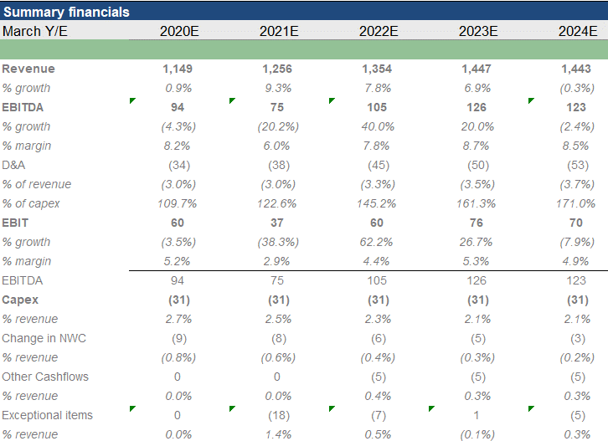
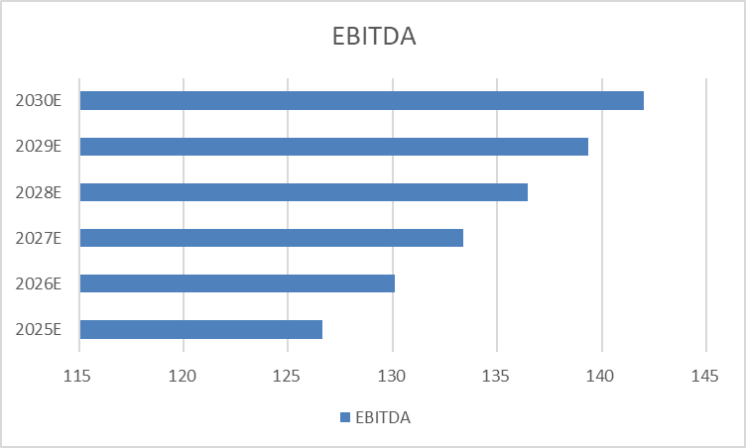
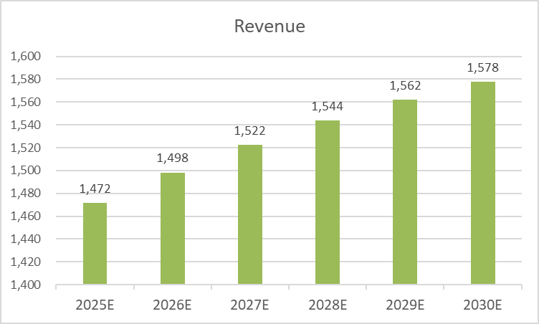
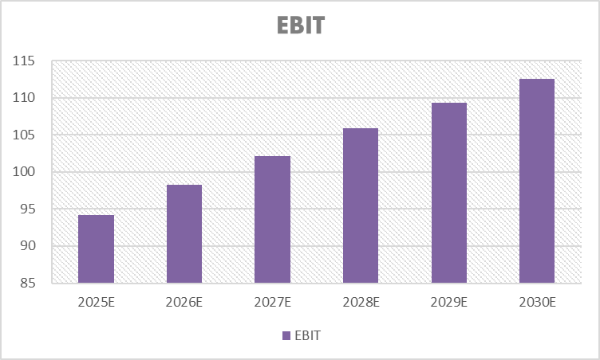
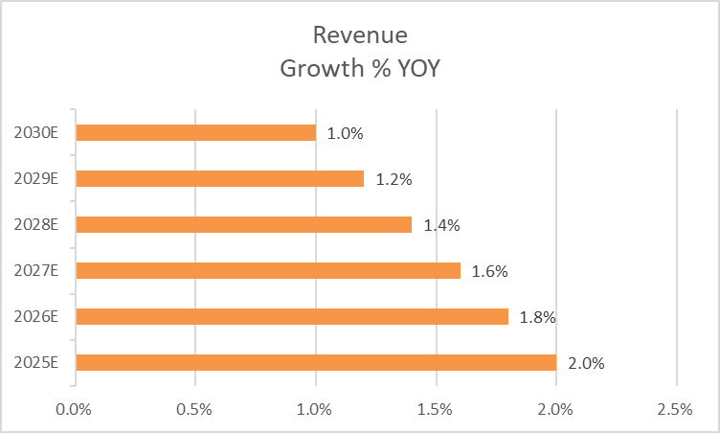
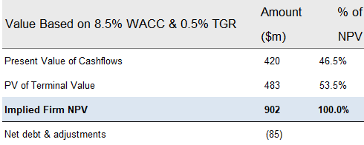
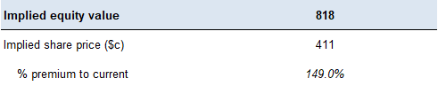
Illustrative DCF analysis for Happy Hour Co
Broker cae
Management case
Summary financials and cash flow
Management estimates
J.P. Morgan outside-in extrapolation
Net present value based on perpetuity growth method
Sensitising firm value ($m) and implied offer price to WACC and TGR
1
Source: Company Business Plan (January 2020); Equity research; J.P. Morgan analysis

